Slide 1
Linear Algebra
Introduction
Department of Computer Engineering
Sharif University of Technology
Hamid R. Rabiee rabiee@sharif.edu
Maryam Ramezani maryam.ramezani@sharif.edu

Slide 2
Course Description
How is our course?

Slide 3



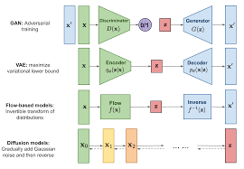
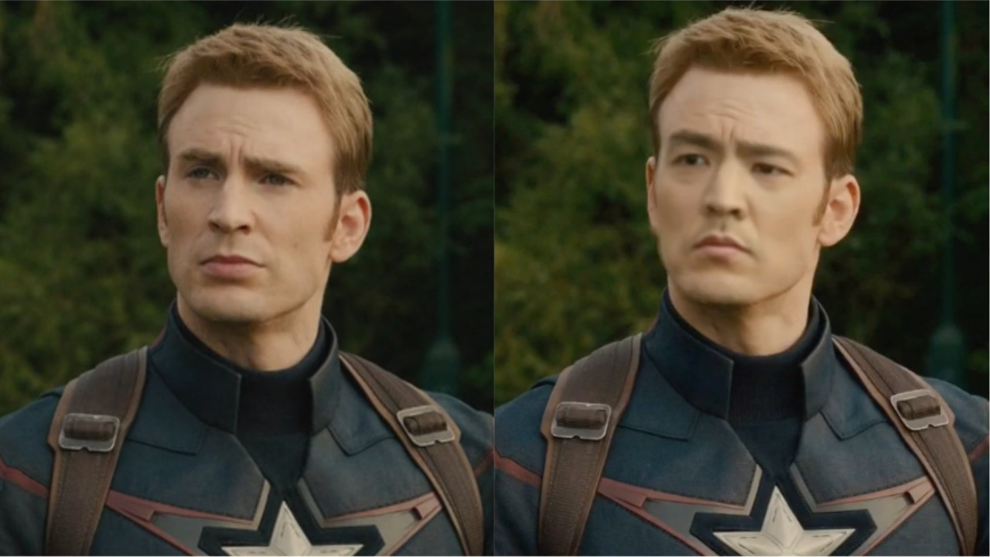
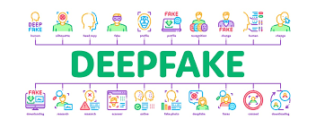
Machine Learning Mathematics

Slide 4
Machine Learning Mathematics
01
02
03
04
05
06
Linear Algebra
Statistics & Probability
Optimization
Provides the foundation for manipulating data in high-dimensional spaces, essential for vector operations in machine learning.
Offers tools to model uncertainty and make inferences about data, forming the backbone of many machine learning algorithms.
Focuses on finding the best parameters for a model by minimizing or maximizing an objective function.
Information Theory
Signal Processing
Graph Theory
Analyzes data compression and transmission, helping quantify uncertainty and information gain in machine learning models.
Involves analyzing and transforming data signals, important for handling time-series data and feature extraction in machine learning.
Studies networks of nodes and edges, crucial for understanding relationships in data and complex models like Graph Neural Networks.

Slide 5
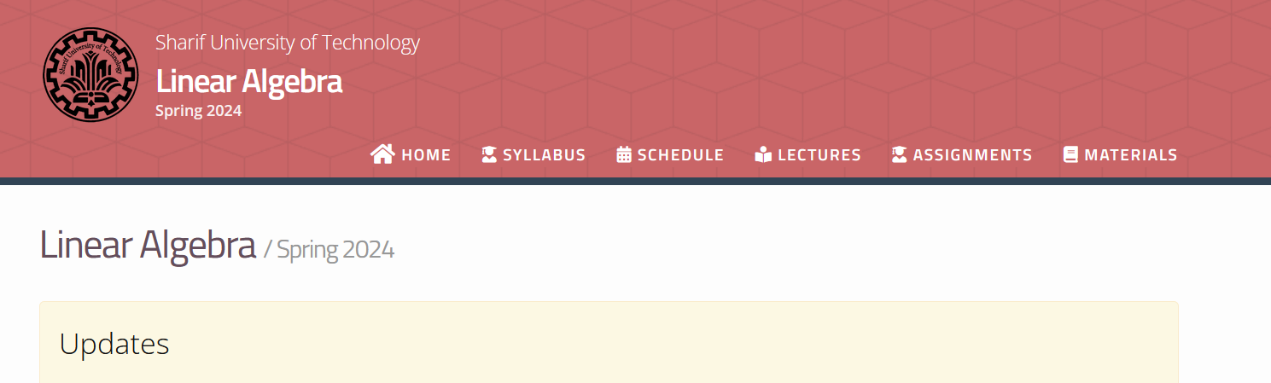
Course Material
https://sut-ce-courses.github.io/linearalgebra (jabrekh.ir)

Slide 6
Course Method
Slides
Writing on board
Geometric Interpretation and Intuition
Notebooks
Example
Definition
Notes
Theorem

Slide 7

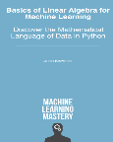
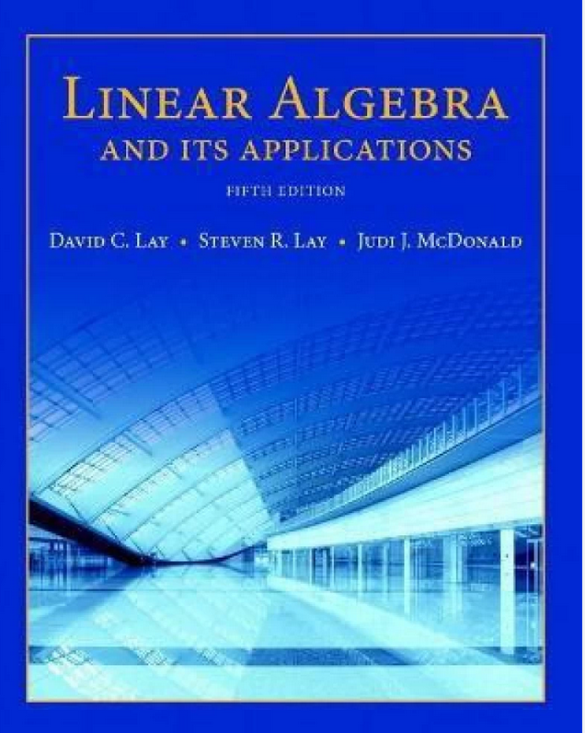
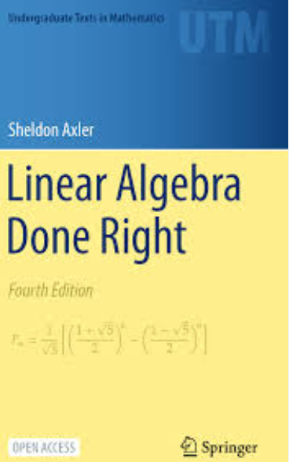
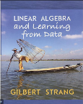
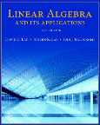
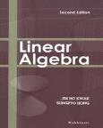
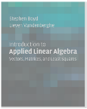
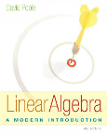
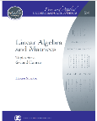
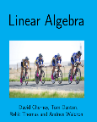
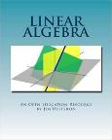
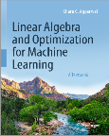
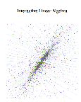
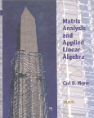
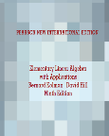
Course References

Slide 8
Reach Us!
Office Room: CE802-CE803
Email:
Hamid R. Rabiee: (rabiee@sharif.edu)
Maryam Ramezani: (maryam.ramezani@sharif.edu)
Course notes, homework and solutions, handouts, and other useful resources are available on the course page:
https://quera.org/course/18745/
Room: (Sunday & Tuesday: 13:30-15:00)
Ebnesina Alef 17
https://vc.sharif.edu/ch/rabiee
Lead TA:
Mohammad Javad Ahmadpour: (mohamadahmadpour1383@gmail.com)
Feedback
https://forms.gle/ox1gUHtbh9DCRgH29

Slide 9
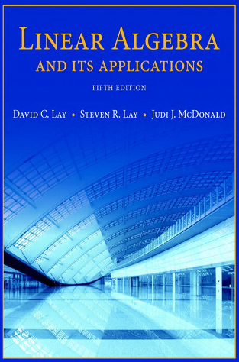
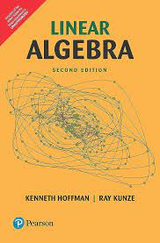
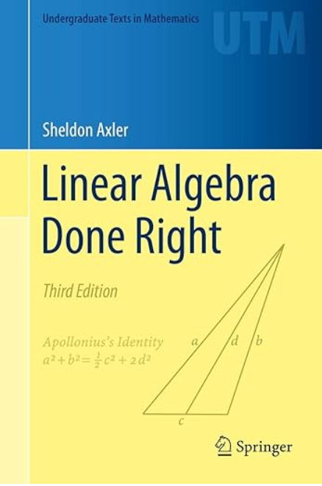
Resources
Textbooks:
Sheldon Axler, Linear Algebra Done Right, fourth edition, 2023
Kenneth Hoffman and Ray A. Kunze.Linear Algebra. PHI Learning, 2004.
Gilbert Strang. Introduction to Linear Algebra. Wellesley-Cambridge Press, 2016.
David C. Lay, Steven R. Lay, and Judi J. McDonald.Linear Algebra and Its Applications. Pearson, 2016.
+Other textbooks and course materials.

Slide 10
Structure of the Course
Goal: To introduce concepts in linear algebra, and motivate their use and importance.
Note: We try to cover useful materials in class, but we recommend you reading more!
Lectures
Assignments
Purpose: To give you a chance to exercise your mind, and to solidify the concepts introduced to you in class.
Structure: Six theorical problems, and Three linear algebra practical problems.
Importance: Not important unless you want to learn the material and get a good grade.
Quiz: 5 with dropping lowest
Midterm: 1
Final: 1
Exams

Slide 11
Lecture Notes
Lecture slide will be uploaded.
Many times we will write on board, in real-time, during lecture to prove a theory or answer a question or add some additional explanations. It will be your responsibility to take notes.
Slides links will be provided on site.

Slide 12
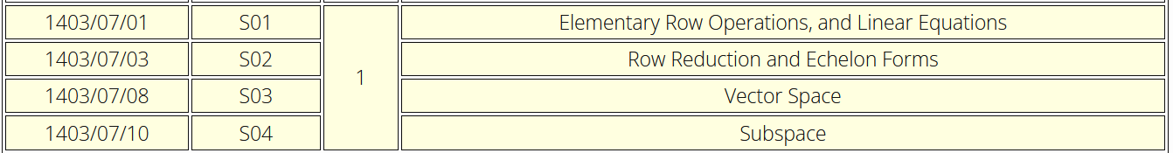
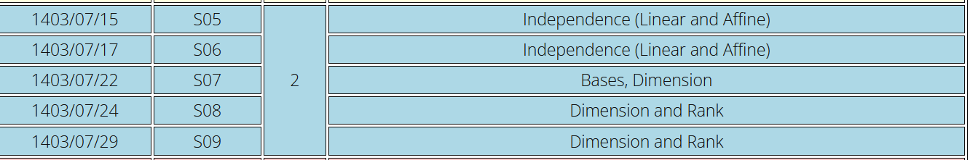
Syllabus

Slide 13
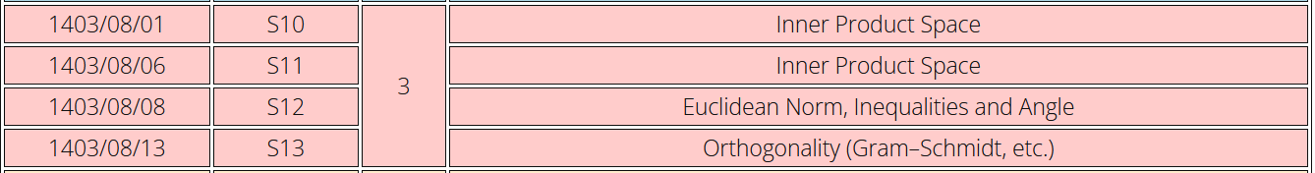
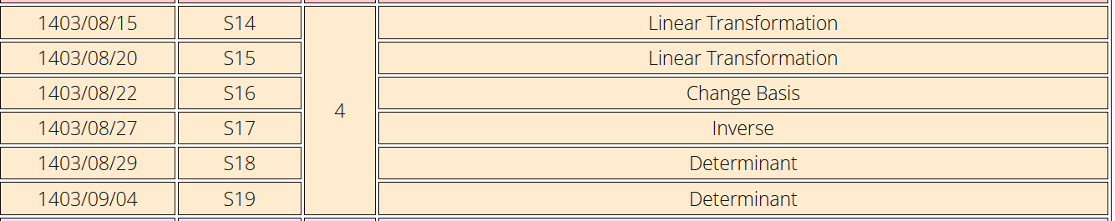
Syllabus

Slide 14
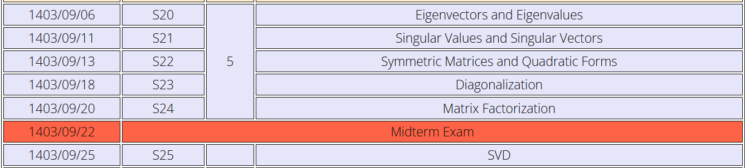
Syllabus

Slide 15
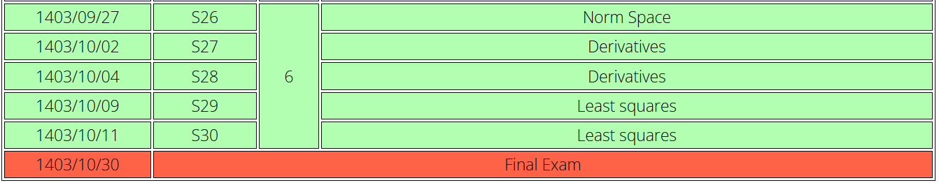
Syllabus

Slide 16
Assignments
6 Theory
3 Programming
Basic NumPy for array manipulation
Learning linear algebra and application of machine learning.
You have a total 4 days of allowed late submission (for each theoretical and code parts). 0.5% of the assignment grade will be subtracted for each hour of delay.
Homework released at the beginning of each part and your responsed should be uploaded on Quera.

Slide 17
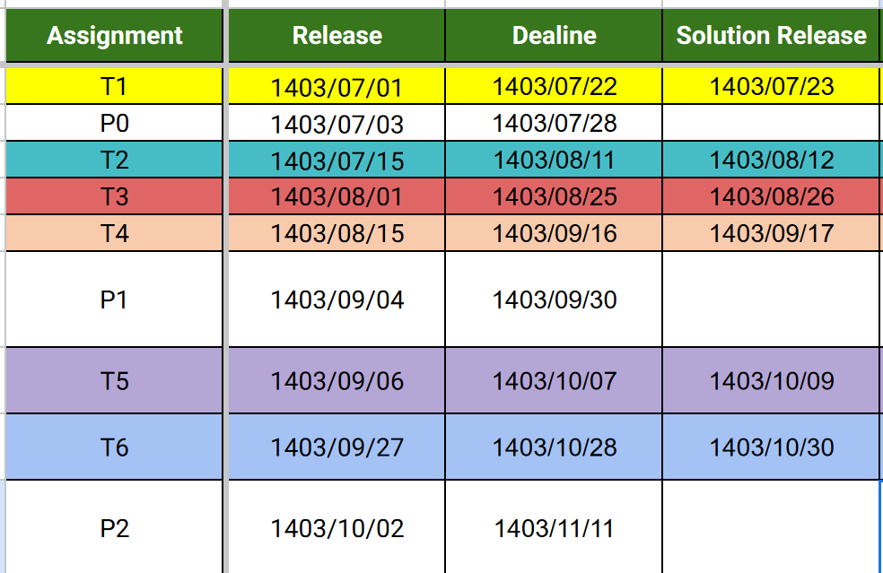
Assignments

Slide 18
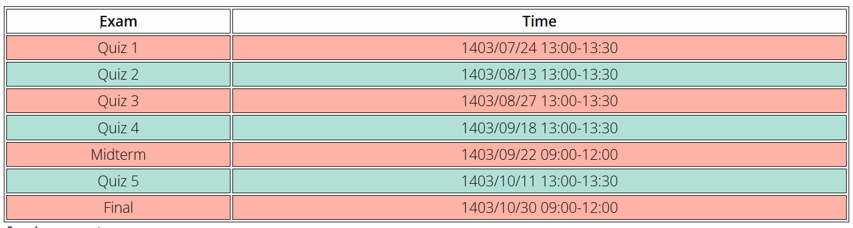
Exams Quizzes will be held as the following table on 13:00 for half an hour and will be graded in Grade Scope.

Slide 19
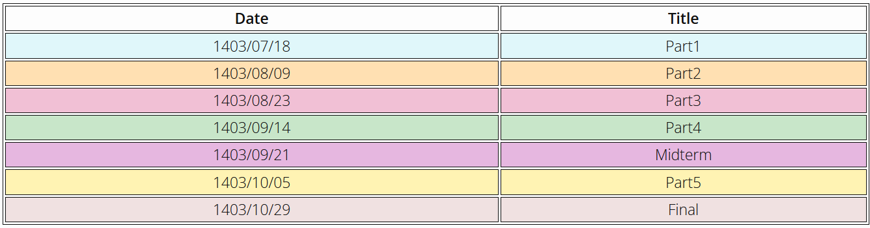
TA Classes TA Classes will be held on Wednesday from 18:00 till 20:00 in room https://vc.sharif.edu/rabiee-ta.

Slide 20
Grading Policy
Quizzes
Written Assignments
Programming
Assignments
3 points (5 quizzes each 0.75 points; the lowest score will be dropped)
5.6 points (each of the first four is 0.85 points, and each of the last two is 1.1 points)
2.4 points (preliminary exercises: 0.4 points, and the next two exercises are each 1 points)
Midterm
Final
5 points (Lectures part 1,2,3,4)
5 points (Lectures part 5,6)
Total: 21 Points

Slide 21
Introduction
Lets think about a question!

Slide 22
01
Vector
Basic Concept

Slide 23
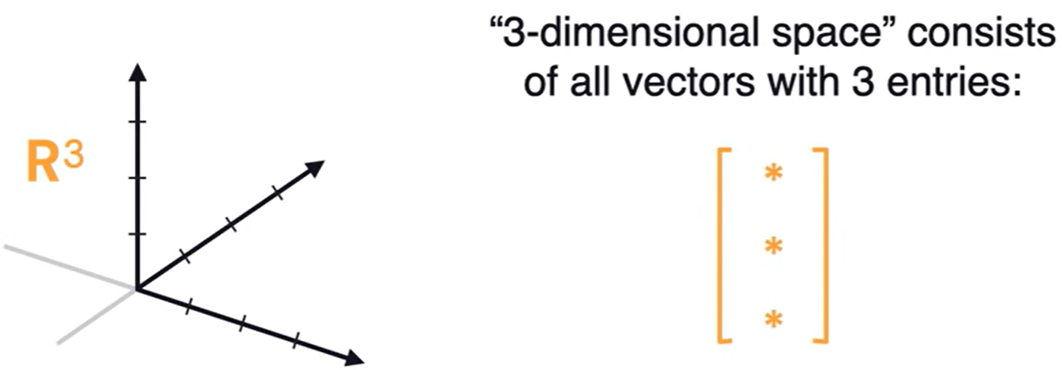
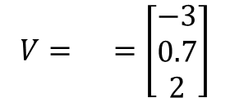
Data Representations (Linear Algebra)
How can we represent data (images, text, user preferences, etc.) in a way that computers can understand?
Organize information into a vector!
A vector is a 1-dimensional array of numbers.
It has both a magnitude (length) and a direction
The totality of a vectors with n entries is an n-dimensional vector space.
$$V= =\left[\begin{aligned}−3 \\ 0.7 \\ 2\end{aligned}\right]$$

Slide 24
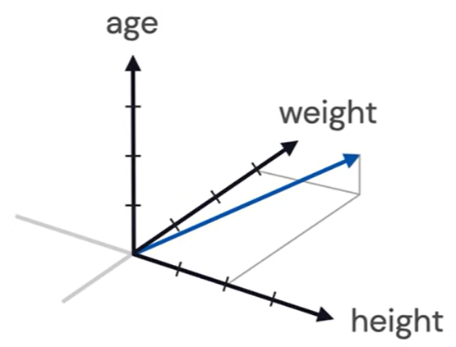
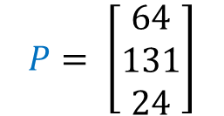
Data Representations (Machine Learning)
A feature vector is a vector whose entries represent the “features” of an object.
The vector space containing them is called feature space.
$$P= \left[\begin{aligned}64 \\ 131 \\ 24\end{aligned}\right]$$
height
weight
age

Slide 25
02
Equation with Matrix and Vector Format
House Pricing Example

Slide 26
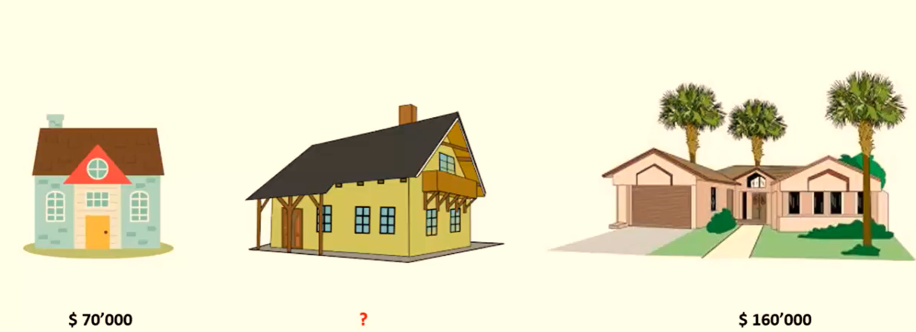
Price Problem

Slide 27
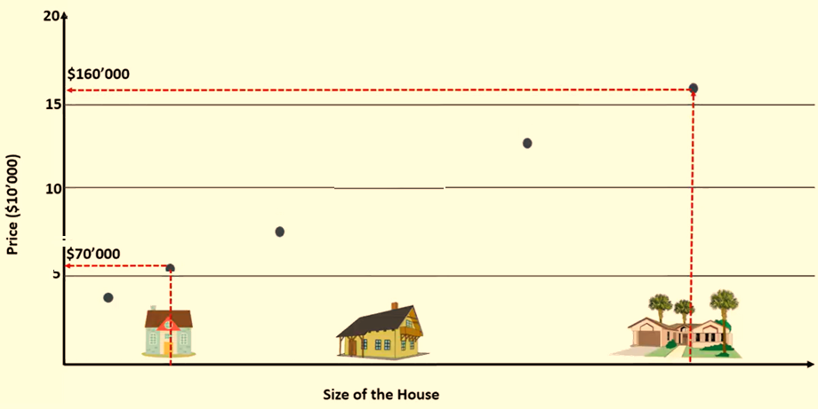
Price Problem
Linear Equation

Slide 28
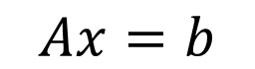
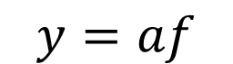
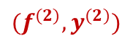
Linear Equation without offset
$$y=af$$
How to convert it to matrix-vector multiplication?
Price: y
$$Ax=b$$
$$(f^{(2)},y^{(2)})$$
Size: f

Slide 29

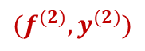
Linear Equation with offset
$$y=af+c$$
How to convert it to matrix-vector multiplication?
$$(f^{(2)},y^{(2)})$$
Price: y
$$Ax=b$$
Size: f

Slide 30
House Features
#Room
Size
#Bedroom
Age
Address features: Street, Alley, …
Size of part1, part2, part3, part4
Floors
#Bathrooms
…

Slide 31
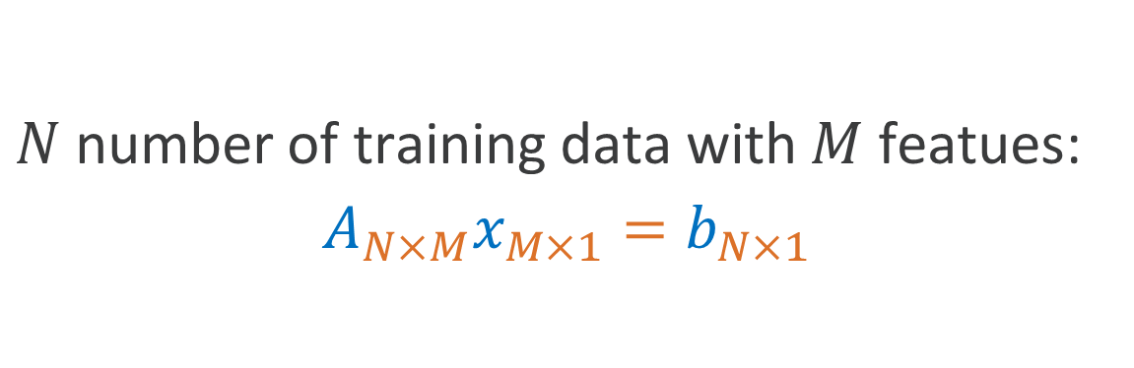
Linear Equation
$N$number of training data with $M$ featues:
$$A_{N×M}x_{M×1}=b_{N×1}$$

Slide 32
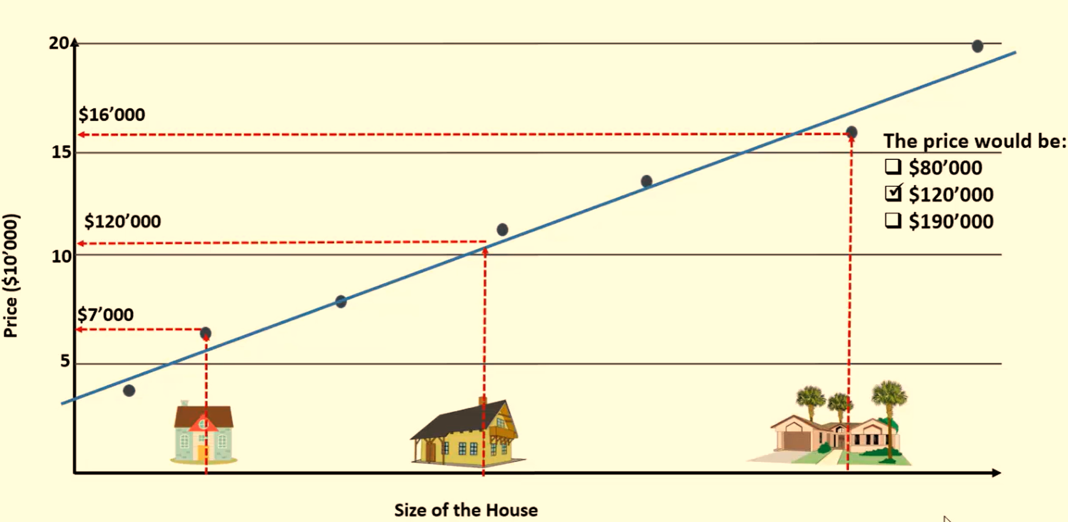
Least Squares Error Correction

Slide 33
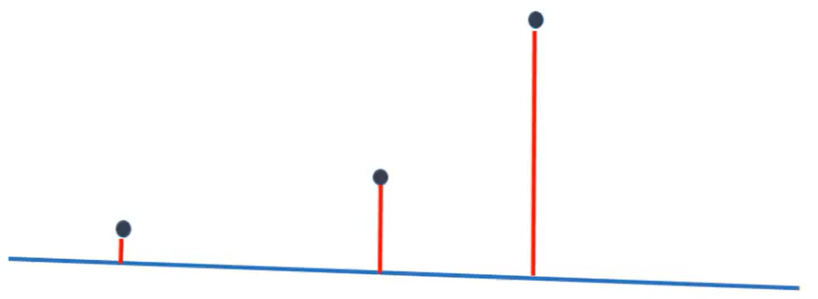
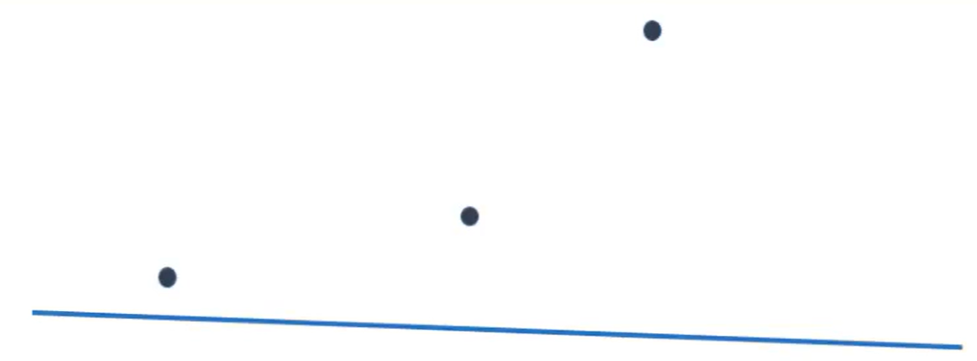
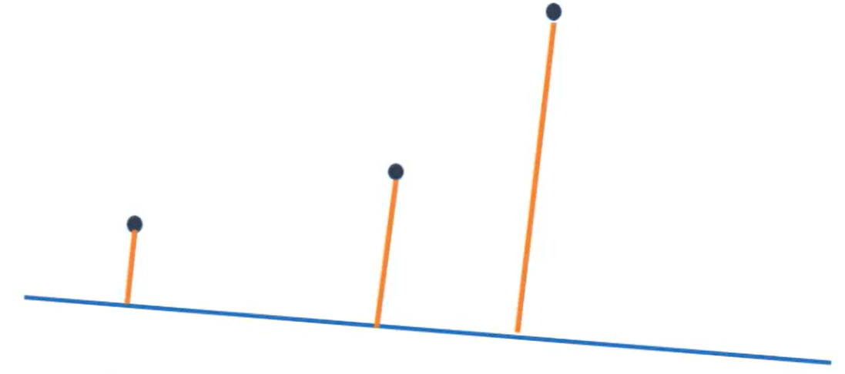
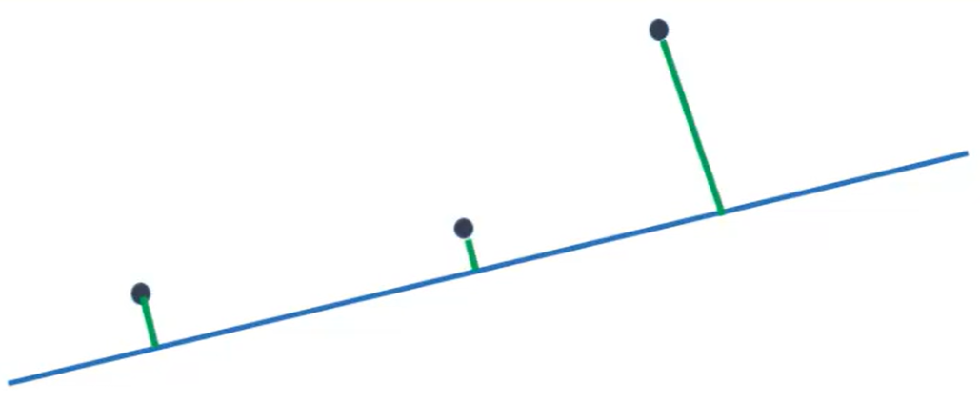
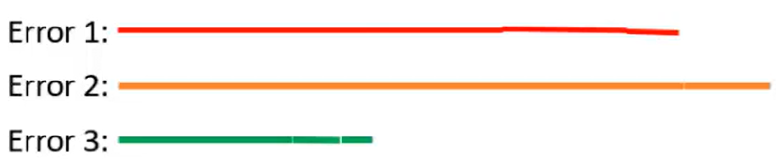
Least Squares Error Correction

Slide 34
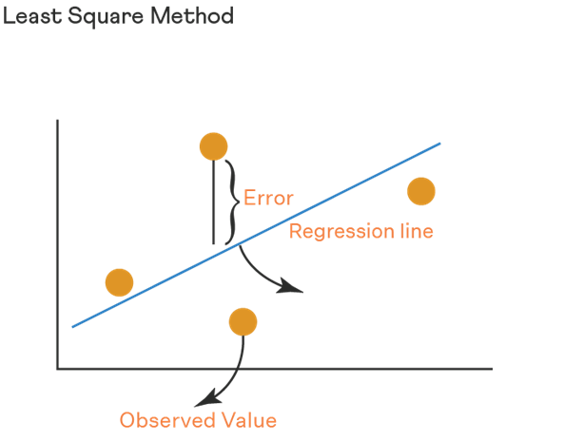
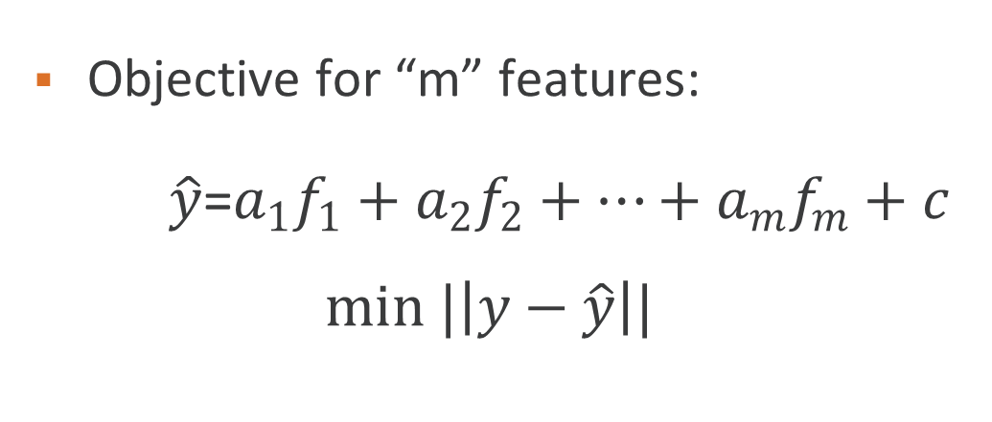

Least Squares
Objective for “m” features:
$\hat{y}$=$a_{1}f_{1}+a_{2}f_{2}+…+a_{m}f_{m}+c$
$$min |\left|y−\hat{y}\right||$$
y
$$y=af+c$$
f

Slide 35


Linear Algebra and Machine Learning Application
$Ax=b → x=A^{−1}b$ Inverse of Matrix/Pseudo Inverse
Regression
Notes:
https://www.youtube.com/watch?v=EDPCsD6BzWE

Slide 36
02
Road Map
Step by Step

Slide 37


